Slide 1
Chapter Five
Architecture in The Life Cycle
By: Abenezer Fantu

Slide 2
Chapter outline
How Much Architecture?
Agility and Architecture Methods
A Brief Example of Agile Architecting
Guidelines for the Agile Architect
Summary

Slide 3
Agility
Agile processes were a response to a need for projects to
be more responsive to their stakeholders
be quicker to develop functionality that users care about
show more and earlier progress in a project’s life cycle
be less burdened by documenting aspects of a project that would inevitably change.
These needs are not in conflict with architecture.
The question for a software project is not “Should I do Agile or architecture?” Instead ask:
“How much architecture should I do up front versus how much should I defer until the project’s requirements have solidified somewhat?”
“How much of the architecture should I formally document, and when?”
Agile and architecture are happy companions for many software projects.

Slide 4
Agile Manifesto

Slide 5
Twelve Agile Principles
Our highest priority is to satisfy the customer through early and continuous delivery of valuable software.
Welcome changing requirements, even late in development. Agile processes harness change for the customer’s competitive advantage.
Deliver working software frequently, from a couple of weeks to a couple of months, with a preference to the shorter timescale.
Business people and developers must work together daily throughout the project.
Build projects around motivated individuals. Give them the environment and support they need, and trust them to get the job done.
The most efficient and effective method of conveying information to and within a development team is face-to-face conversation.
Working software is the primary measure of progress.
Agile processes promote sustainable development. The sponsors, developers, and users should be able to maintain a constant pace indefinitely.
Continuous attention to technical excellence and good design enhances agility.
Simplicity—the art of maximizing the amount of work not done—is essential. “Ideas are cheap, implementing those ideas is rarely cheap!”
The best architectures, requirements, and designs emerge from self-organizing teams.
At regular intervals, the team reflects on how to become more effective, then tunes and adjusts its behavior accordingly.

Slide 6
Agile
These processes were initially employed on small- to medium-sized projects with short time frames and enjoyed considerable success.
They were not often used for larger projects, particularly those with distributed development.

Slide 7
Agility and Documentation
Write for the reader!
If the reader doesn’t need it, don’t write it.
But remember that the reader may be a maintainer or other newcomer not yet on the project!

Slide 8
Agility and Architecture Evaluation
Architecture evaluation work as part of an Agile process? Absolutely.
Meeting stakeholders’ important concerns is a cornerstone of Agile philosophy.
Our approach to architecture evaluation is exemplified by the Architecture Tradeoff Analysis Method (ATAM).
ATAM does not endeavor to analyze all, or even most, of an architecture.
The focus is determined by a set of quality attribute scenarios that represent the most important of the concerns of the stakeholders.
It is easy to tailor a lightweight architecture evaluation.

Slide 9
Guidelines for the Agile Architect
Barry Boehm and colleagues have developed the Incremental Commitment Model to blend agility and architecture.
This model is based upon the following principles:
Commitment and accountability of success-critical stakeholders
Stakeholder “satisficing” (meeting an acceptability threshold) based on success-based negotiations and tradeoffs
Incremental and evolutionary growth of system definition and stakeholder commitment
Iterative system development and definition
Interleaved system definition and development allowing early fielding of core capabilities, continual adaptation to change, and timely growth of complex systems without waiting for every requirement and subsystem to be defined
Risk management—risk-driven anchor point milestones, which are key to synchronizing and stabilizing all of this concurrent activity

Slide 10
Final Advise
If you are building a large, complex system with relatively stable and well-understood requirements and/or distributed development, doing a large amount of architecture work up front will pay off.
On larger projects with unstable requirements, start by quickly designing a candidate architecture even if it leaves out many details.
Be prepared to change and elaborate this architecture as circumstances dictate, as you perform your spikes and experiments, and as functional and quality attribute requirements emerge and solidify.
On smaller projects with uncertain requirements, at least try to get agreement on the major patterns to be employed. Don’t spend too much time on architecture design, documentation, or analysis up front.

Slide 11
Summary
The Agile Manifesto and principles value close-knit/strongly matching teams, with continuous, frequent delivery of working software.
Agile processes were initially employed on small- to medium-sized projects with short time frames. They were seldom/infrequently used for larger projects, particularly with distributed development.
Large-scale successful projects need a blend of agile and architecture.
Agile architects take a middle ground, proposing an initial architecture and running with that, until its technical debt becomes too great, at which point they need to refactor.
Boehm and Turner found that projects have a “sweet spot” where up-front architecture planning pays off.

Slide 12
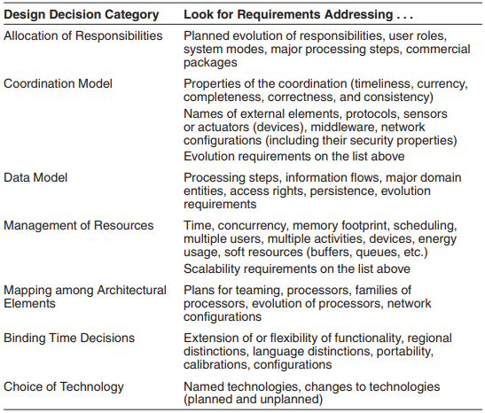
Architecture and Requirement
Sniffing Out ASR (architecturally significant requirements) from a requirements document

Slide 13
Architecture and Requirement
Gathering ASR s by Interviewing Stakeholders - One such method is the Quality Attribute Workshop (QAW), described in the sidebar. From book...
Gathering ASRs by understanding business goals (basic intention, reason or concerns)
Business goals often lead to quality attribute requirements.
Business goals may directly affect the architecture without precipitating a quality attribute requirement at all. (non architectural solutions)
No influence at all.

Slide 14
Continued...
Capturing ASRs in a utility tree
ASRs : A profound impact on the architecture and A high business or mission value
Under each refinement, record the appropriate ASRs (usually expressed as QA scenarios)
e.g. performance might be decomposed into “data latency” and “transaction throughput.” Or it might be decomposed into “user wait time” and “time to refresh web page.
Once the ASRs are recorded and placed in the tree, you can now evaluate them against the two criteria we listed above:

Slide 15
Continued...
Architectures are driven by architecturally significant requirements: requirements that will have profound effects on the architecture.
Architecturally significant requirements may be captured from requirements documents, by interviewing stakeholders, or by conducting a Quality Attribute Workshop.
In gathering these requirements, we should be mindful of the business goals of the organization.
Business goals can be expressed in a common, structured form and represented as scenarios.
A useful representation of quality attribute requirements is in a utility tree. The utility tree helps to capture these requirements in a structured form, starting from coarse, abstract notions of quality attributes and gradually refining them.

Slide 16
Designing an Architecture
Design Strategy
- Decomposition : decomposition of a component in a components-and-connectors (C&C) pattern and into its subcomponents.
For example, a user interface implemented using the model-view-controller (MVC) pattern would be decomposed into a number of components for the model, one or more views, and one or more controllers.
- Designing to architecturally Significant requirements - What about the non-ASR requirements?
- (a) You can still meet the other requirements. (b) You can meet the other requirements with a slight adjustment of the existing design, and this slight adjustment does not keep the higher priority requirements from being met. (c) You cannot meet the other requirements under the current design.

Slide 17
Continued...
Existing systems
Frameworks.
Patterns and tactics
Domain decomposition
Design checklists

Slide 18
The Attribute-Driven Design Methods
Choose a part of the system to design.
Marshal all the architecturally significant requirements for that part.
Create and test a design for that part Inputs of ADD
ASRs and context description - What are the boundaries of the system being designed?
- What are the external systems, devices, users, and environmental conditions with which the system being designed must interact?

Slide 19
Continued...
Output of ADD
Sketches of architectural views.
The steps of ADD
- ADD is a five-step method: 1. Choose an element of the system to design. 2. Identify the ASRs for the chosen element. 3. Generate a design solution for the chosen element. 4. Inventory remaining requirements and select the input for the next iteration. 5. Repeat steps 1–4 until all the ASRs have been satisfied.

Slide 20
Continued...
1. Choose the element of the system to design. For green-field designs, the “part” to begin with is simply the entire system.
For designs that are already partially completed (either by external constraints or by previous iterations through ADD), the part is an element that is not yet designed.
2. Identify the ASRs for the chosen element.
3. Generate a design solution for the chosen element, using design collateral such as existing systems, frameworks, patterns and tactics, and the design checklists
4. Verify and refine requirements and generate input for the next iteration.
- Either the design in step 3 will satisfy all of the chosen element’s ASRs or it won’t.
- If it doesn’t, then either they can be allocated to elements that will be elaborated in future iterations of ADD, or the existing design is inadequate and we must backtrack.
- Furthermore, non-ASR requirements will either be satisfied, allocated to children, or indicated as not achievable.

Slide 21
Continued...
5. Repeat steps 1–4 until all the ASRs have been satisfied, or until the architecture has been elaborated sufficiently for the implementers to use it.

Slide 22
Documenting Software Architectures
Outline
Uses of documentations
Views
Categorizes of views
Stakeholder needs
Seven rules for document

Slide 23
Introduction
The software architecture plays a central role in system development.
It is a blueprint for both the system and the project developing it.
It defines work assignments.
It is the primary carrier of system qualities.

Slide 24
Uses of Architectural Documentation
A perfect architecture is useless if no one understands it or if key stakeholders misunderstand it
Documentation is a crucial part of producing a good architecture
Document should be
sufficiently abstract to be quickly understood by new employees
sufficiently detailed to serve as a blueprint for analysis

Slide 25
Uses of Architectural Documentation
Architecture documentation has three main uses
Architecture serves as a means of education
Architecture serves as a primary vehicle for communication among stakeholders
Architecture serves as the basis for system analysis and construction
Notes:
The educational
use consists of introducing people to the system. The people
may be new members of the team, external analysts, or
even a new architect. In many cases, the “new” person is the
customer to whom you’re showing your solution for the
first time, a presentation you hope will result in funding or
go-ahead approval.

Slide 26
Who Use the Architectural Documentation
Role | Description | Uses
Analyst | Responsible for analyzing the architecture to make sure it meets certain critical quality attribute requirements. | Analyzing satisfaction of quality attribute requirements of the system based on its architecture.
Architect | Responsible for the development of the architecture and its documentation. | Negotiating and making trade-offs among competing requirements and design approaches.
Business manager | Responsible for the functioning of the business/organizational entity that owns the system. | Understanding the ability of the architecture to meet business goals.
Customer | Pays for the system and ensures its delivery. | Assuring required functionality and quality will be delivered, gauging progress, estimating cost, and setting expectations for what will be delivered, when, and for how much.

Slide 27
Who Use the Architectural Documentation
Role | Description | Uses
Deployer | Responsible for accepting the completed system from the development effort and deploying it, making it operational | Understanding the architectural elements that are delivered and to be installed at the customer’s or end user’s site, and their overall responsibility toward system function.
Designer | Responsible for systems and/or software design | Understanding the architectural elements that are designed
Implementer | Responsible for the development of specific elements according to designs, requirements, and the architecture. | Understanding inviolable constraints and exploitable freedoms on development activities.
Integrator | Responsible for taking individual components and integrating them, according to the architecture and system designs. | Producing integration plans and procedures, and locating the source of integration failures.

Slide 28
Notations for Architecture Documentation
Informal notations
Semiformal notations
Formal notations

Slide 29
Views
A view is a representation of a coherent set of architectural elements, as written by and read by system stakeholders.
There are many views for an architecture.
Documenting an architecture is a matter of documenting the relevant views and then adding documentation that applies to more than one view.

Slide 30
Categories of View Styles
Module views
Component-and-connector (C&C) views
Allocation views

Slide 31
Module Views
A module is an implementation unit that provides a coherent set of responsibilities (examples: classes, layers,…)
It is unlikely that the documentation of any software architecture can be complete without at least one module view

Slide 32
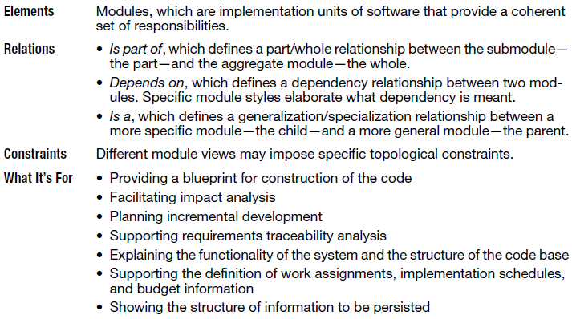
Module Views

Slide 33
Module View Styles
Decomposition
Uses
Generalization
Layers
Aspects
Data model

Slide 34
Notations for Module Views
Informal notations
Dependency Structure Matrix
UML
Entity-Relationship Diagram

Slide 35
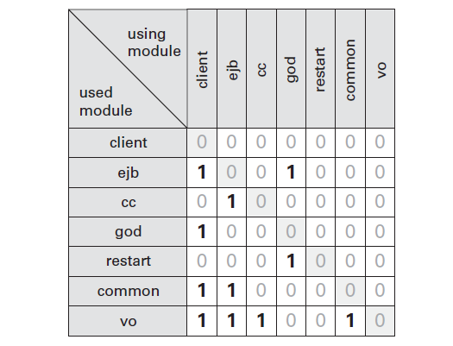
Dependency Structure Matrix

Slide 36
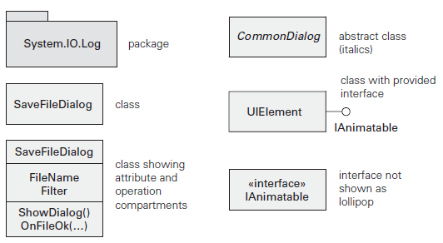
Module Notations in UML

Slide 37
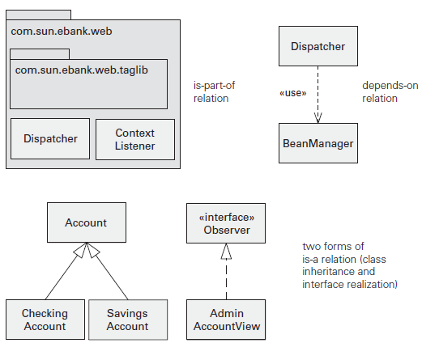
Module Relations in UML

Slide 38
Component-and-connector Views
Component-and-connector views show elements that have some runtime presence such as processes, objects, clients, and servers

Slide 39
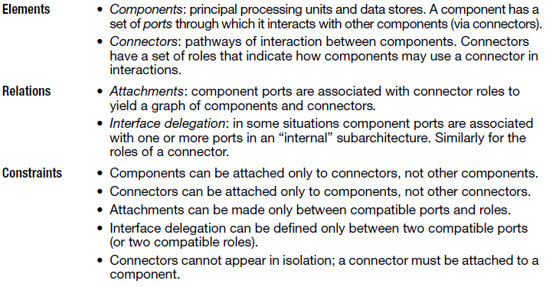
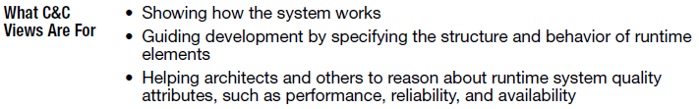
Component-and-connector Views

Slide 40
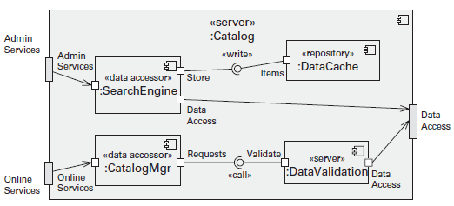
C&C Views in UML

Slide 41
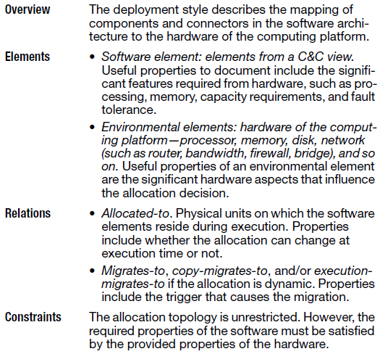
Allocation Views

Slide 42
Allocation View Styles
Deployment
Install
Work assignment

Slide 43
Notations for Allocation Views
Informal notations
Formal notations
UML

Slide 44
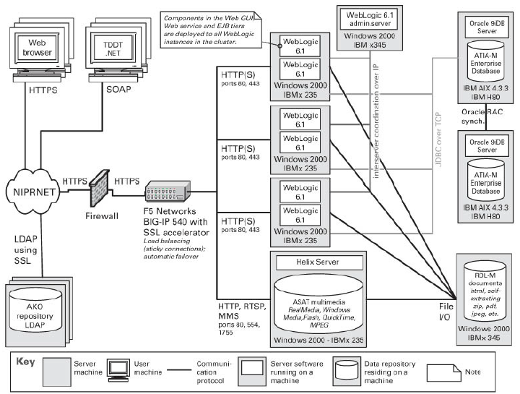
Informal notations

Slide 45
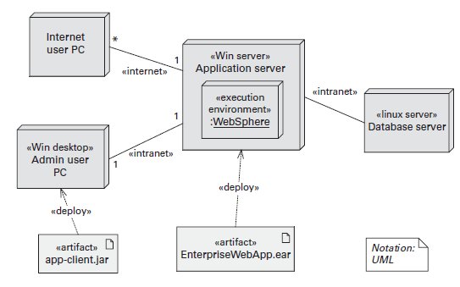
UML Notations

Slide 46
Documenting Architectures
Documenting an architecture is a matter of documenting the relevant views and then adding documentation that applies to more than one view.
The principle for documenting an architecture
Choosing the relevant views
Documenting a view
Documenting information that applies to more than one view

Slide 47
Choosing the Views
Determine which views are required, when to create them, and how much detail to include
Information needed
What people, and with what skills, are available
With which standards you have to comply
What budget is on hand
What the schedule is
What the information needs of the important stakeholders are

Slide 48
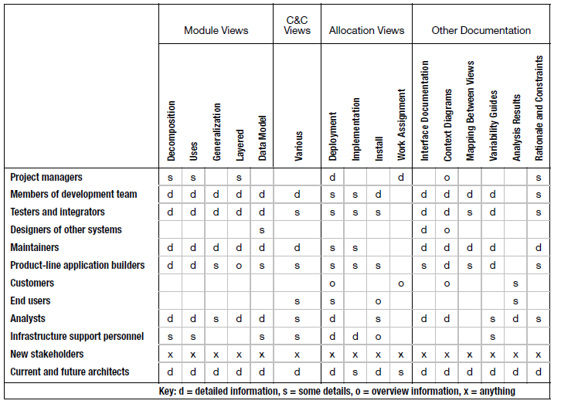
Summary of needs

Slide 49
Documenting a View
A primary presentation, usually graphical, that depicts the primary elements and relations of the view
An element catalog that explains and defines the elements shown in the view and lists their properties
A context diagram shows how the system or portion of the system depicted in this view relates to its environment
A variability guide explaining any variation points that are a part of the architecture shown in this view
Rationale explains why the design is as it is

Slide 50
Documentation across views
An introduction to the entire package, including a reader’s guide that helps a stakeholder find a desired piece of information quickly
Information describing how the views relate to one another, and to the system as a whole
Constraints and rationale for the overall architecture

Slide 51
Seven Rules for Sound Documentation
Write documentation from the reader’s point of view
Find out who your readers are, what they know, and what they expect of the document.
Avoid unnecessary insider jargon
Avoid unnecessary repetition
Avoid ambiguity (explain your notation)
Use a standard organization
It helps the reader navigate the document and find specific information quickly
It also helps the document writer plan and organize the contents.
It reveals what work remains to be done by the number of sections labeled “TBD”

Slide 52
Seven Rules for Sound Documentation
Record rationale
Keep documentation current but not too current
Review documentation for fitness of purpose

Slide 53
Summary
Uses of documentations
Views
Categorizes of views
Stakeholder needs
Seven rules for document

Slide 54
Architecture, Implementation, and Testing
Architecture and Implementation
Architecture and Testing
Summary

Slide 55
Architecture and Implementation
Four techniques to help keep the code and the architecture consistent:
Embedding the design in the code
Frameworks
Code templates
Keeping code and architecture consistent (i.e. avoiding “architecture erosion”)

Slide 56
Embedding the Design in the Code
Architecture acts as a blueprint for implementation. This means
Implementers know what architectural structure they are implementing. E.g. layer, pub/sub, MVC, broker, …
They can document the architectural structure in the code as comments. Then anyone picking up the code will know some of the constraints.
Projects should have conventions about how to do this. Then tools can automatically relate the code and the architecture.

Slide 57
Frameworks
A framework is a reusable set of classes organized around a particular theme.
A programmer uses the services provided by a framework.
Examples are
Ruby on Rails is based on MVC is designed for web applications. It offers the ability to gather information from the web server, talk to or query the database, and render templates.
AUTOSAR is designed for the computers inside of automobiles.

Slide 58
Code Templates
A code template is collection of code within which the programmer provides application specific portions.
The example below implements a failover protocol:
In the event that a failure is detected in a critical-application component, a switchover occurs as follows:
A secondary copy, executing in parallel in background on a different processor, is promoted to the new primary.
The new primary reconstitutes with the application’s clients
A new secondary is started to serve as a backup for the new primary.
The newly started secondary announces itself to the new primary.
If failure is detected within a secondary, a new one is started on some other processor.

Slide 59
Code Templates
Process:
Use the code template for every critical component that must have a hot standby.
Place application specific code in fixed places within the template.

Slide 60
Advantages of Code Templates
Components with similar properties behave in a similar fashion.
Template only needs to be debugged once.

Slide 61
Keeping Code and Architecture Consistent
The implementation will drift away from the documented architecture.
Implementers may make decisions that are not consistent either with each other or with the architecture.
The architecture may not have foreseen all eventualities that come up.

Slide 62
Preventing Architecture Erosion
Use tools to enforce architectural constraints.
can have architecture rules added that are enforced during a build or check in.
Mark documentation as out of date when erosion occurs. Will give more credence to remaining portion.
Schedule documentation/code synchronization times.

Slide 63
Architecture and Testing
Unit test
Integration test
Network effects
Test activities

Slide 64
Unit Test
Architecture defines the units that are to be tested. They are components or modules.
Architecture defines the responsibilities and interactions of the units.
Test harness (collection of software and test data ) will drive the element to be tested. The test harness can test:
Responsibilities for functional correctness
Performance through synthetic loads
Availability through fault injection. i.e. what happens if a component on which the component being tested does not respond.
Modifiability requirements can also be tested by assigning changes to test teams.

Slide 65
Integration Test
As with unit test, integration test can test functionality, performance, availability, and security.
Security can be tested by having the test harness execute various attack scenarios.
Systems may degrade after being run for a long time if resources are not freed or a configuration is incorrectly specified.

Slide 66
Network Effects
Suppose an error causes a 2% performance degradation.
This is within normal variation if using one server
May cause severe degradation if system is deployed to thousands of servers.
Configuration errors are common during installation and can lead to network effects. i.e. routing a message through an intermediary rather than directly will introduce latency.
Network effects are best found through self-aware systems, i.e. system monitors itself and makes values available externally.

Slide 67
Test Activities
The architect should be actively involved in
Test planning, since the architect knows the sensitive areas of the system.
Test development. Test driven development is a technique where the next increment of the system is developed to satisfy a predetermined test.
Test interpretation. The architect knows what various monitored values should be and is best equipped to interpret test results.
Test harness creation. The test harness has to intimately interact with the system and this requires architecture knowledge.
- a collection of software and test data used by developers to unit test software models during development.

Slide 68
Summary
Implementation
Implementation activities can embed architecture knowledge in the code
Templates can be used for critical sections that reoccur
Architecture erosion can be prevented through use of tools and management processes
Testing
Unit and integration tests depend on architectural knowledge and a test harness.
Network effects are difficult to discover when deploying a system to 1000s of servers.
The architect should be involved in a wide variety of test activities.

Slide 69
Architecture Reconstruction and Conformance
Outline
Architecture Reconstruction Process
Raw View Extraction
Database Construction
View Fusion
Architecture Analysis: Finding Violations
Guidelines
Summary

Slide 70
Why Reconstruction?
Suppose you have been given responsibility for a system that already exists, but you do not know its architecture.
Perhaps the architecture was never recorded by the original developers, now long gone.
Perhaps it was recorded but the documentation has been lost.
Perhaps it was recorded but the documentation is no longer synchronized with the system after a series of changes.
How do you maintain such a system?
How do you manage its evolution to maintain the quality attributes that its architecture has provided?

Slide 71
Purposes of Reconstruction
To document an architecture where the documentation never existed or where it has become hopelessly out of date
To ensure conformance between the as-built architecture and the as-designed architecture.
In architecture reconstruction, the as-built architecture is reverse-engineered from existing system artifacts.

Slide 72
Reconstructing Mappings
When a system is initially developed, its architectural elements are mapped to specific implementation elements: functions, classes, files, objects, and so forth.
When we reconstruct those architectural elements, we need to apply the inverses of the original mappings:
Use automated and semi-automated extraction tools
Probe/explore the original design intent of the architect.
Typically we use a combination of both techniques

Slide 73
Tools for Reconstruction
Architecture reconstruction is a tool-intensive activity.
Tools extract information about the system, typically by scouring the source code.
They may also analyze other artifacts as well, such as build scripts or traces from running systems.
We need tools that aid in building and aggregating the architectural abstractions that we need.
If our tools are usable and accurate, the end result is an architectural representation that aids the architect in reasoning about the system.
Understand for Java(UFJ), JDepend, Enterprise Architect, ARMIN (Architectural Reconstruction and MINing), Structural Analysis for Java.

Slide 74
…but not Just Tools
Architecture reconstruction tools are not a panacea/full remedy.
It may not be possible to generate a useful architectural representation.
Not all aspects of architecture are easy to automatically extract.
E.g., there is no programming language construct in any major programming language for “layer” or “connector” or other architectural elements; we can’t simply pick these out of a source code file.
Architecture reconstruction is an interpretive, interactive, and iterative process involving many activities; it is not automatic.
It requires the skills and attention of both the reverse-engineering expert and, in the best case, the architect (or someone who has substantial knowledge of the architecture).

Slide 75
Reconstruction Workbenches
An architecture reconstruction workbench should be open (making it easy to integrate new tools as required) and provide an integration framework whereby new tools that are added to the tool set do not impact the existing tools or data unnecessarily.

Slide 76
Reconstruction Phases
Raw view extraction.
Raw information about the architecture is obtained from various sources, primarily source code, execution traces, and build scripts.
Each of these sets of raw information is called a view.
Source artifacts (code, header files, build files, and so on) and other artifacts (e.g., execution traces), you can identify and capture the elements of interest within the system (e.g., files, functions, variables) and their relationships to obtain several base system views.
Database construction.
Convert the raw extracted information into a standard form
Use that to populate a reconstruction database.
We will use the database to generate authoritative architecture documentation.

Slide 77
Reconstruction Phases
View fusion and manipulation.
Combines the various views of the information stored in the database.
Individual views may not contain complete or fully accurate information. View fusion can improve the overall accuracy.
Example: a static view extracted from source code might miss dynamically bound information such as calling relationships. This could then be combined with a dynamic view from an execution trace, which will capture all dynamically bound calling information, but which may not provide complete coverage.
Architecture analysis.
View fusion will result in a set of hypotheses about the architecture. These hypotheses take the form of architectural elements (such as layers) and the constraints and relationships among them. These hypotheses need to be tested to see if they are correct.
If not, repeat earlier steps.

Slide 78
Reconstruction Phases

Slide 79
Guidelines
Have a goal and a set of objectives or questions in mind before undertaking an architecture reconstruction project.
Obtain some representation, however coarse, of the system before beginning the detailed reconstruction process. This representation serves several purposes, including the following:
It identifies what information needs to be extracted from the system.
It guides the reconstructor in determining what to look for in the architecture and what views to generate.
Identifying layers is a good place to start.

Slide 80
Guidelines
The existing documentation for a system may not accurately reflect the system as it is implemented. Therefore it may be necessary to disregard the existing documentation.
Tools can support the reconstruction effort and shorten the reconstruction process, but they cannot do an entire reconstruction effort automatically.
The work involved in the effort requires the involvement of people (architects, maintainers, and developers) who are familiar with the system.

Slide 81
Summary
Architecture reconstruction and architecture conformance are crucial tools in the architect’s toolbox to ensure that a system is built the way it was designed, and that it evolves in a way that is consistent with its creators’ intentions.
The results of architectural reconstruction can be used in several ways:
If no documentation exists or if it is seriously out of date, the recovered architectural representation can be used as a basis for documenting the architecture.
It can be used to recover the as-built architecture, or to check conformance against an “as-designed” architecture.
The reconstruction can be used as the basis for analyzing the architecture or as a starting point for reengineering the system to a new desired architecture.
The representation can be used to identify elements for reuse or to establish an architecture-based software product line.

Slide 82
Summary
The software architecture reconstruction process comprises the following phases:
Raw view extraction
Database construction
View fusion
Architecture analysis

